Slide 1
Architecture Design Part 3 : DTO
arnaud.nauwynck@gmail.com
Entity – DTO, external APIs, Protocol Marshalling, Mapper
This document:
http://github.com/arnaud-nauwynck/Presentations/java/ Architecture-Design-part3-DTO.pdf

Slide 2
External Protocol … Marshalling/Unmarshalling to Internal Langage
Receive messages from external
Input Channel
(= Connection,Queue or others?)
Message Request
Unmarshalling: Message -> Object
Object
Application code
Server-side « Skeleton » implementation
Object
Marshalling: Object -> Message
send response to external
Output Channel
(= Connection,Queue or others?)
Message Response

Slide 3
Message Encoding : Text / Binary
explained
<xml? schema:=« ..xsd » namespace=« ns1:….. » >
<a> <ns1:b> some value</ns1:b> </a>
verbose
+++ most powerfull
+++ Self-explained / extensible
--- most verbose
<xml?> <a> <b> some value</b> </a>
JSON: { « a »: { « b »: « some value » } }
Simplest
Compromise for Web
CSV: a.b; \n
some value
compressed
opaque
Obscure
+++ compressed encoding
+++ efficient int32, long64, float32, ..
CPU representation
Binary: 0101010101101010101010

Slide 4
Schema … Code-Generator
<?xml>
xsd schema
Text
(No code generator)
{ json}
?? No standard
( json-schema,OpenApi,Swagger)
CSV
Header line … Tabular, Not tree
Binary
+ code generator per-langage
Corba,RPC,XRD,..
.idl
Avro
.avsc : Avro-Schema (in json)
Thrift
.idl : Thrift Schema
Protobuf,gRPC
.proto : Protobuf Schema

Slide 5
Schema: Fixed / support version upgrade
Backward-compatibility is mandatory
Still evolutivity possible ? Better if true
PAST
PRESENT
FUTURE
Future = unknown
Only 1 known fact = things will change
…will be possible to keep today vX.Y.Z?
V0
5 years ago
v1
V2
experimental

Slide 6
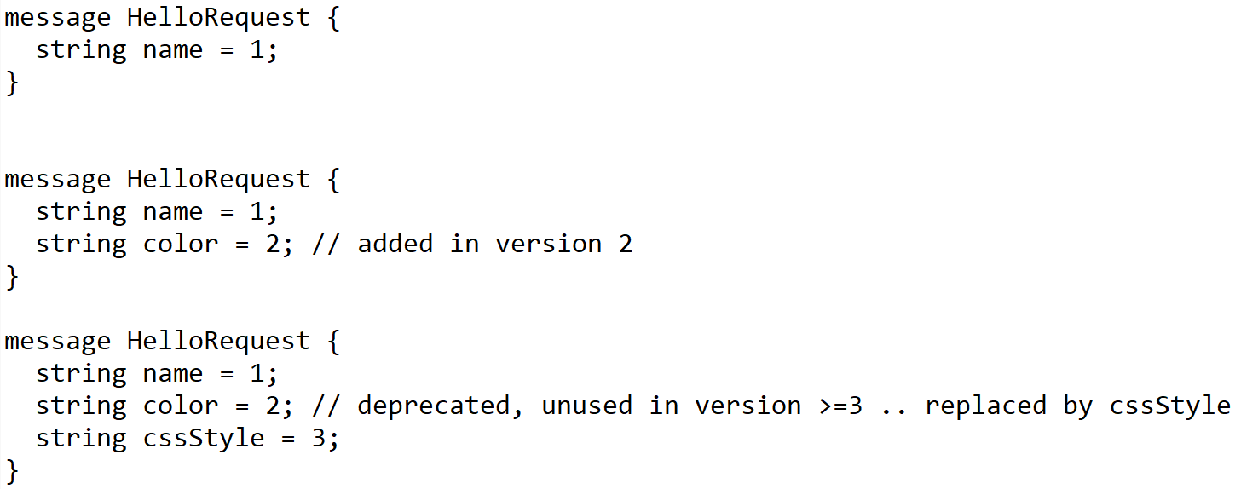
Dynamic Schema: Protobuf, gRPC compiled Versioned Fields
In schema, all fields are numbered (unique ID)

Slide 7

Dynamic Messages, Schema-compatible
Build:
generate
client-v0.exe
.proto
messages from v0 .proto format
In Messages
« Map<FieldId, Value> »
fieldId looks « unneccessary »
Small extra cost
… Great compatibility
1: « Hello »
client-v1.exe
.proto~1
message from v1 .proto format
1: « Hello », 2: « blue »
client-v2.exe
.proto~2
message from v2 .proto format
1: « Hello », 3: « { color: blue }»

Slide 8
Reading « Future » Message / Backward Client … Ignore Unknown Fields
.proto~2
.proto~1
client-v2.exe
client-v1.exe
write
message from v2 .proto format
read
1: « Hello », 3: « { color: blue }»
1: « Hello »
Ignore unknown field « 3 »

Slide 9
Schema Registry
write
read
schemaURL= « ….. Schema vX.Y.Z»
Payload= 01010101101101010101
Schema v0 = {…}
Schema cache
(immutable by ID)
Schema v1 = {…}
Schema cache
(immutable by ID)
Schema v2 = {…}

Slide 10
Schema Contained in Messages
Data Payload
« Hello », { color: blue }
Examples :
Metadata schema:
« { name: String, color: String } »
MetaData
(overhead)
Kafka Messages, Pulsar Messages
Avro Message, Avro Data-File
PARQUET File
for ULTRA compression of millions of rows (dictionnary, incremental, filter..)
java.io.Serializable
Contains serialVersionUID + fully-qualified Names + field name / types
Use « Kryo » instead of « java.io. » for typed / schema-less messages ! (better performances )

Slide 11
Http Json Request <-> Java Object method
http Server Thread (Tomcat, Netty, ..)
DispatcherServlet.handle( httpServletRequest, httpServletResponse)
http 2.0 VERB /path
header=value
.
{ json body }
Socket.read
{json}
Unmarshalling: JSON -> Java Object
(RequestBody -> method param)
java Object
http / TCP-IP Socket
Application code called by introspection
@RequestMapping
Output method(Input..) { …}
Java Object
Marshalling: Java Object -> JSON
(method return -> ResponseBody)
Socket.write
http 200
header=value
.
{ json body }
{json}

Slide 12
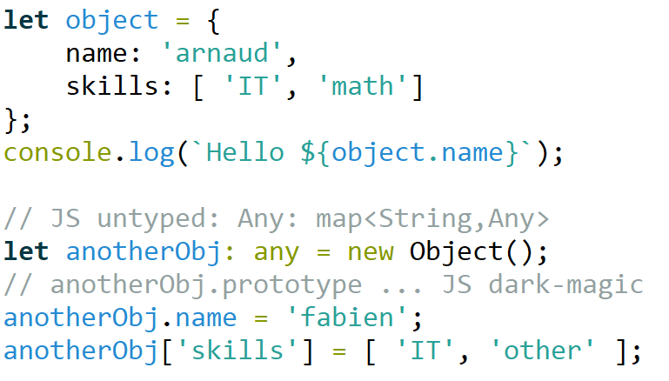
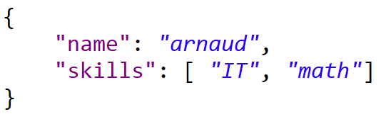
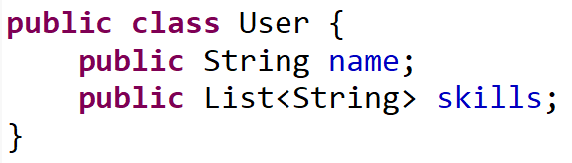




JavaScript <-> Json (JavaScript Object Notation) <-> Java
Script (untyped interpreter)
DATA format (no schema)
Langage (typed)
Web Front-End
Network
encoding
Back-end

Slide 13








http JSON : Open & DeFacto Standard for Portability, Simplicity, Frameworks
Web Front-End
API Front-End (app-to-app)
Network
connection+encoding
Back-end

Slide 14
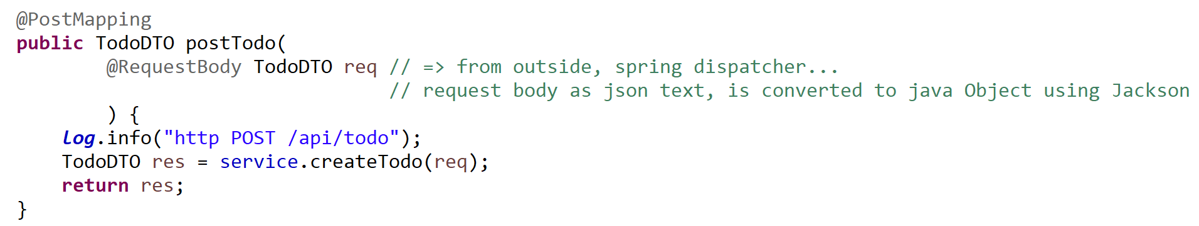
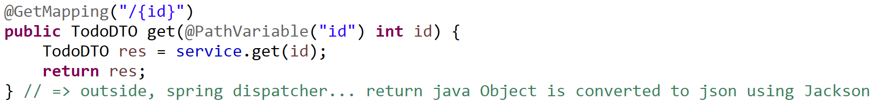
Http Request <-> Spring Java Mappings @RequestMapping, @{Get|Post|..}Mapping, @RequestBody ..

Slide 15
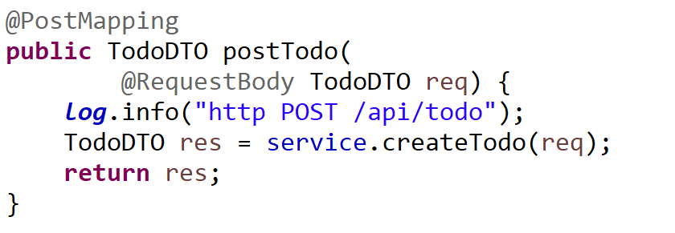
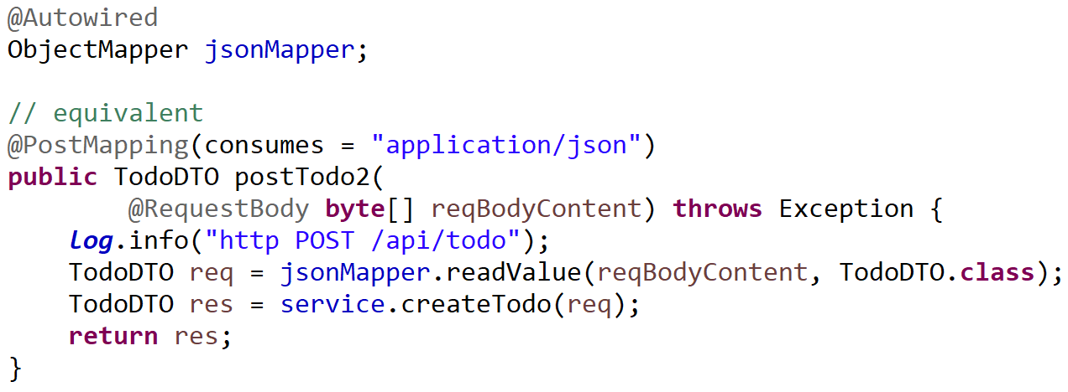
Equivalent Explicit Json Unmarshalling

Slide 16
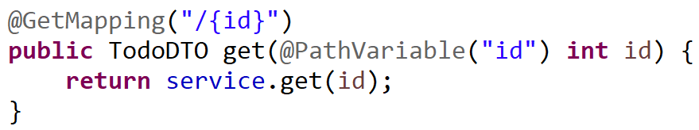
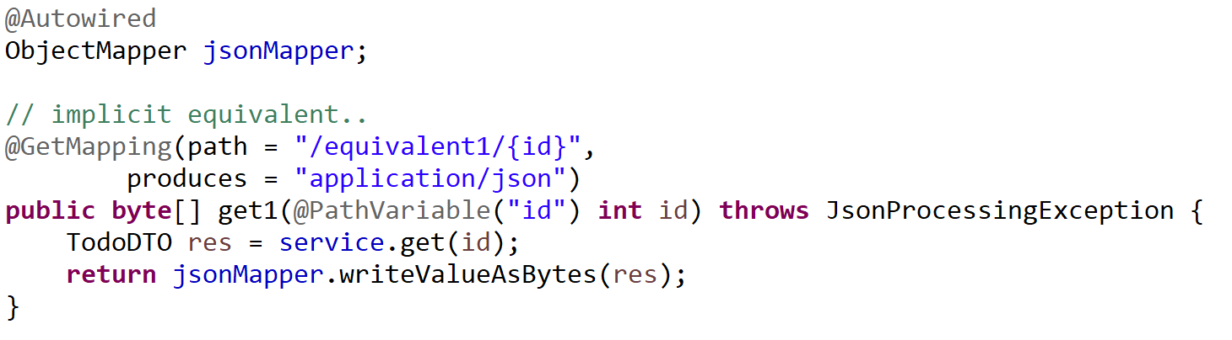
Equivalent Explicit Json Marshalling

Slide 17
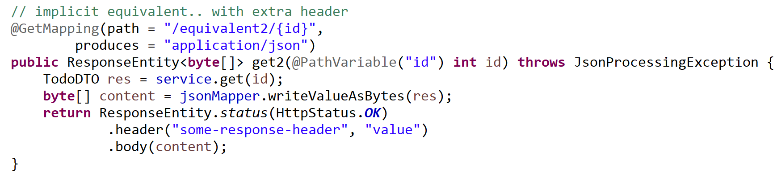
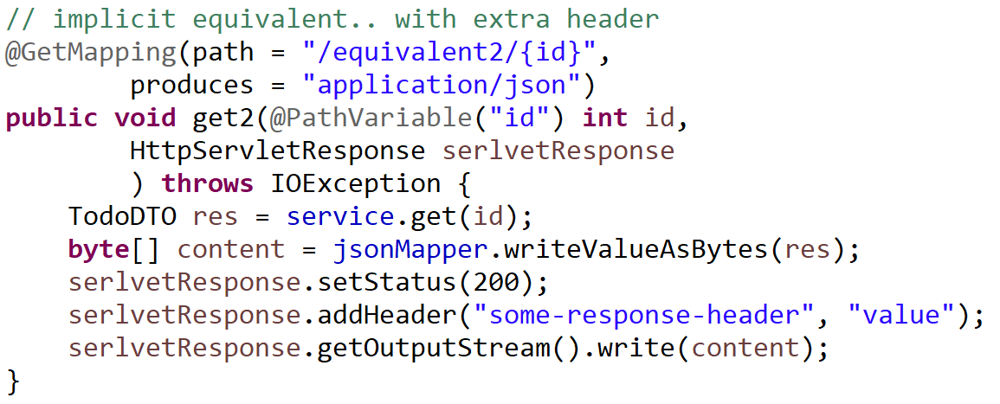
Explicit Equivalent, with http Status + Headers

Slide 18
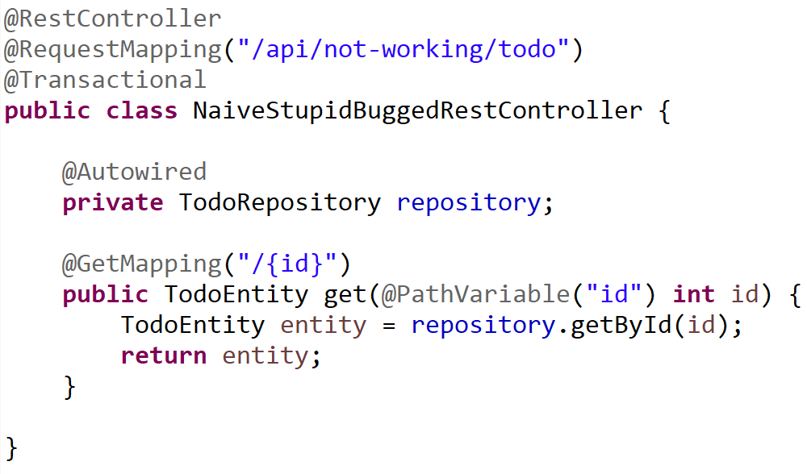
Naive (Not working) @Entity to JSON
Entity class maybe
not JSON compatible
Entity object invalid
After transaction commit
(managed lifecycle)

Slide 19
Why Not using 1 class Entity = DTO ?
0/ does NOT work except on simplicitic entities (Transaction)
1/ internal database is PRIVATE, implementation specific
!= external API is publicly specified
2/ Decoupling helps evolutivity
3/ projection-cuts for complex Entities graph
with cyclic dependencies parent-child (@ManyToOne(mappedBy..) )
4/ several DTO classes/APIs for a single Entity class
5/ Do not use HACKS like @JsonIgnore… (see 0/, 1/, 2/, 3/, 4/ )

Slide 20
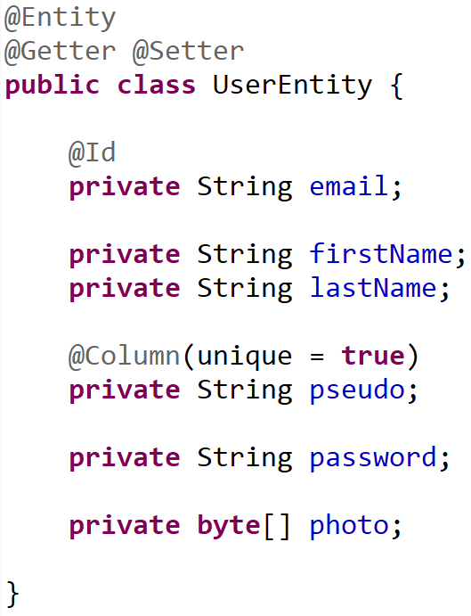
Example Entity class .. Do not export all
Personnal data
Do not publish
Critical Security data
never publish !!
( Except for owner )
High volume data
export only explicitly demanded

Slide 21
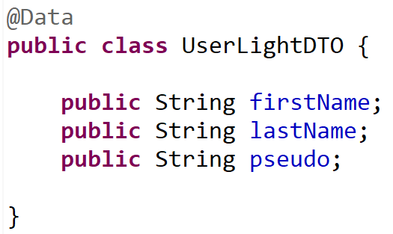
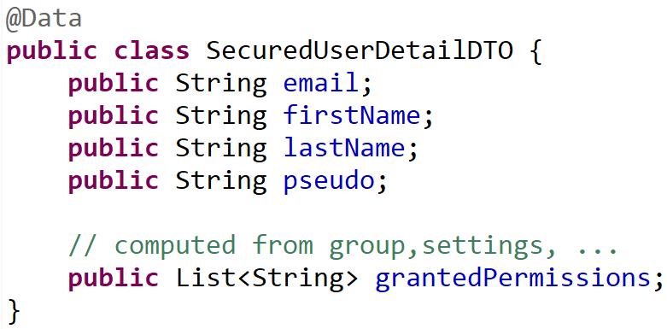
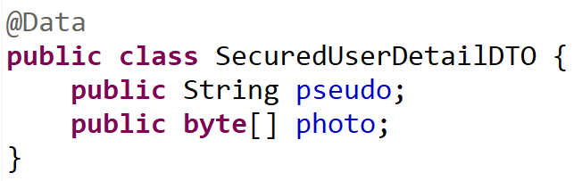
1 Entity class <-> Several specific DTO classes
Default mapping
Owner personal view
Public detailed view (high data volume)

Slide 22
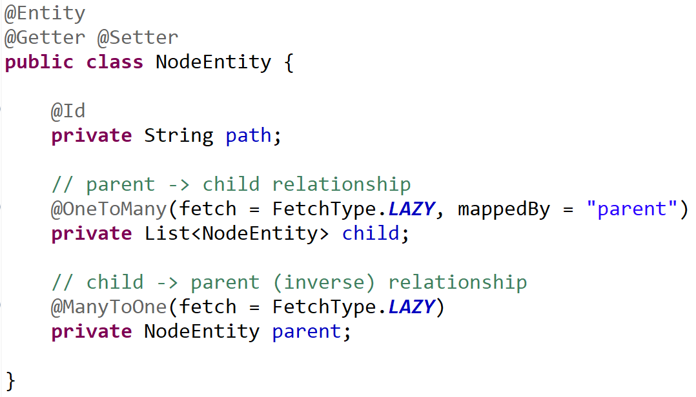
Entity -> Projection DTOs = « Cutting » relations
0..1 parent
NodeEntity
* child
Projection Parent->Children (recursive)
TreeNodeDTO
* child
Projection Child->Parent (recursive)
AncestorNodeDTO
0..1 parent

Slide 23
Reminder Part 2 … Entity lifecycle in Session

Slide 24
Entity : Lifecycle managed by Session (Transaction)
Level1Cache
(=Session )
Read-Write, single-thread
Thread
Begin transaction
@Transactional
method () {
XA (Transaction)
e1 = em.save(new Entity())
e2 = e1.getField()
e3List = repo.findBy(..)
end transaction
} // implicit try-catch-finally
prepareXA => flush Entity changes
Commit XA => commit JDBC
Entity lifecycle ends with XA commit/rollback

Slide 25
Copy Entity data to Transfer before Commit
Thread
Session
Begin transaction
@Transactional
method () {
XA (Transaction)
e = repo.findBy(..)
Dto res = new DTO()
// copy dto entity
res.setField1( e.getField1() );
return res;
end transaction
} // implicit try-catch-finally
Entity lifecycle ends with XA commit/rollback
DTO have no lifecycle ends (only GC to free)

Slide 26
2 Rules : a/ use DTOs != Entities b/ use RestController != (Transactional) Service
Thread
@RestController @RequestMapping
{
Api input checks
@Transactional @Service
{
JPA queries (find entity) / fill from dto
Functional code
entities
Entity to dto
}
dtos
Api output result
}

Slide 27
But it seems to works?? (in « normal » cases)
Bad default value in springboot
To please newbies trying JPA with left hands
Springboot explicitly WARN to change it
Do not simply remove the warn !!! Code is buggy

Slide 28
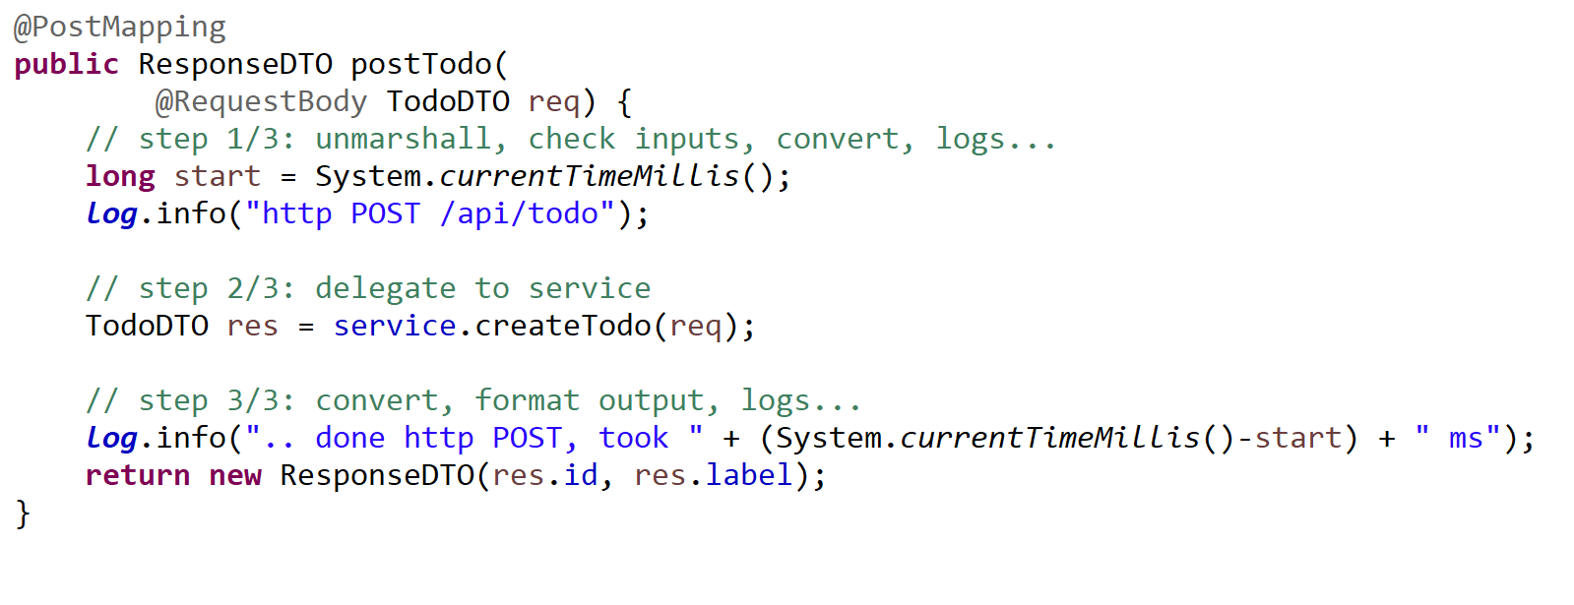
Controller Method Pattern { unmarshal / delegate / marshall }

Slide 29
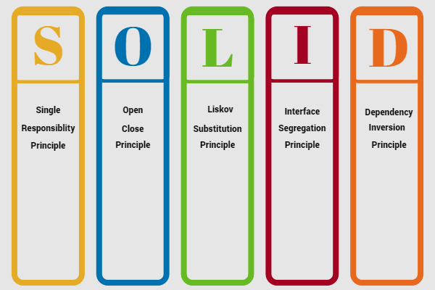
« solid » principles

Slide 30
SOLID RestController …. S = Single
A RestController does only 1 thing :
controls (maps) http Rest requests to Java methods
… delegate all others things to injected Service

Slide 31
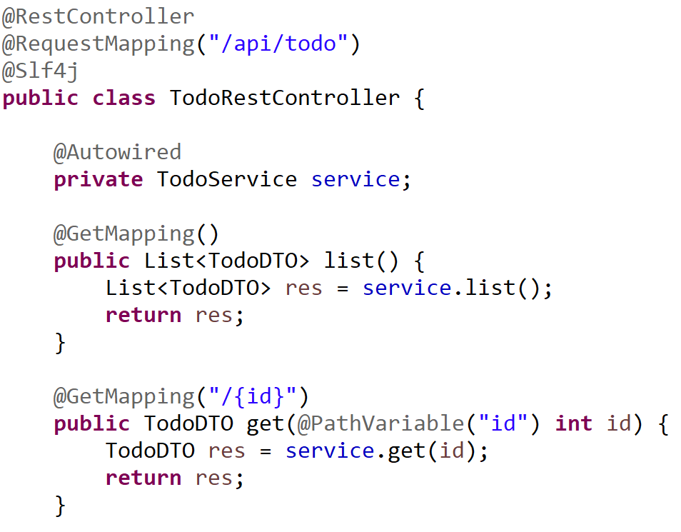
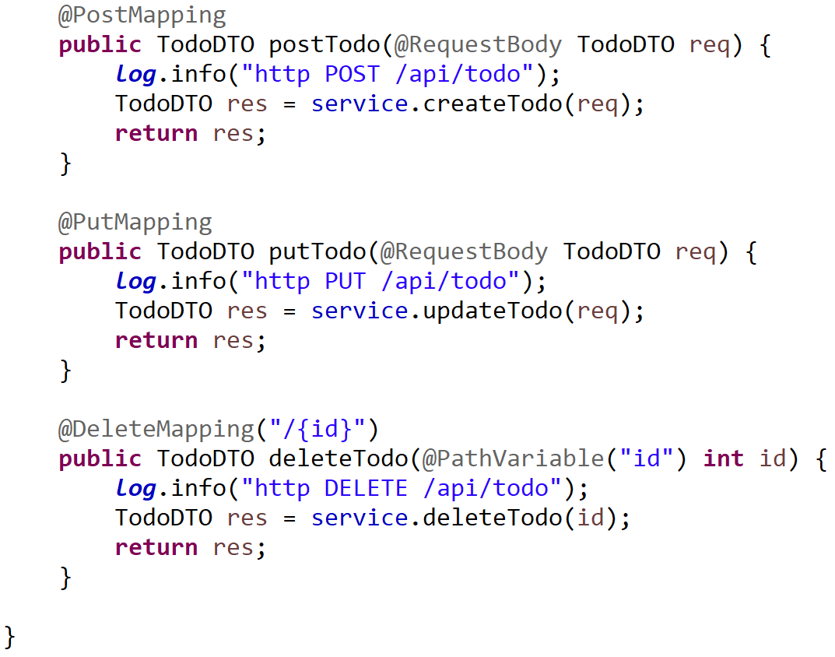
Typical CRUD Rest Controller

Slide 32
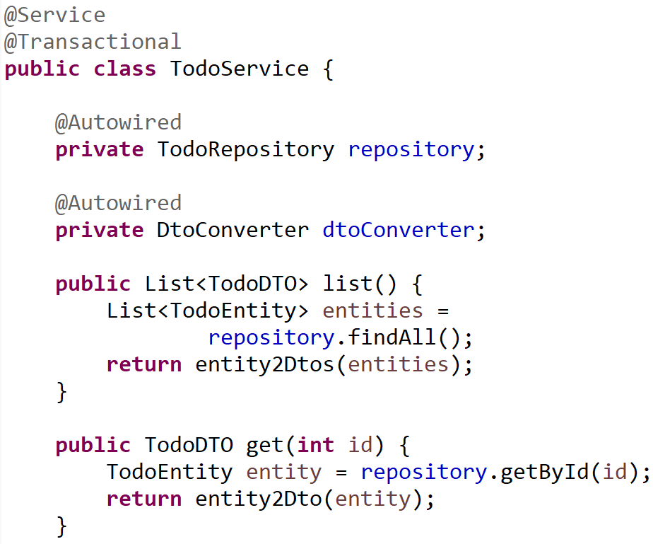
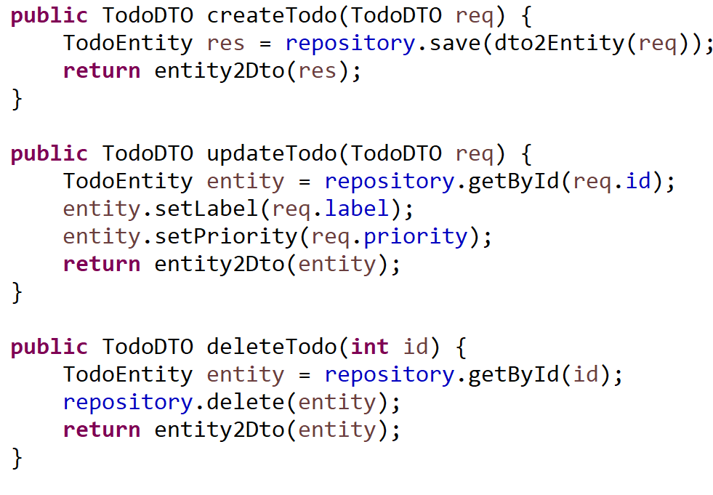
Typical CRUD Transactional Service (1/2)

Slide 33
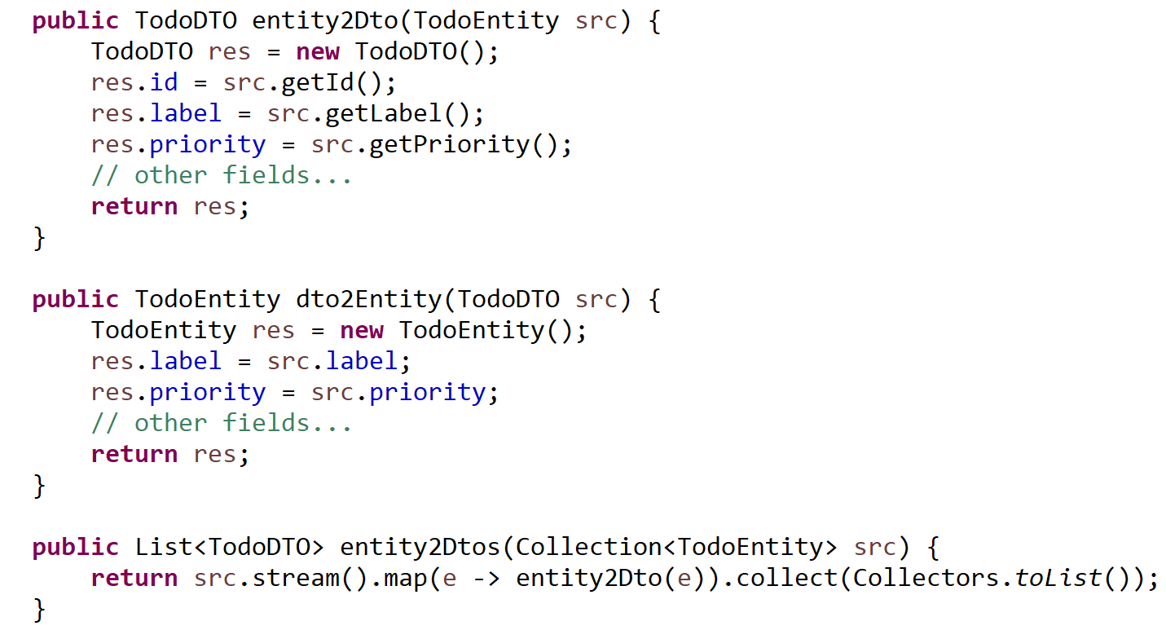
Typical CRUD Service (2/2) entity2Dto / dto2Entity

Slide 34
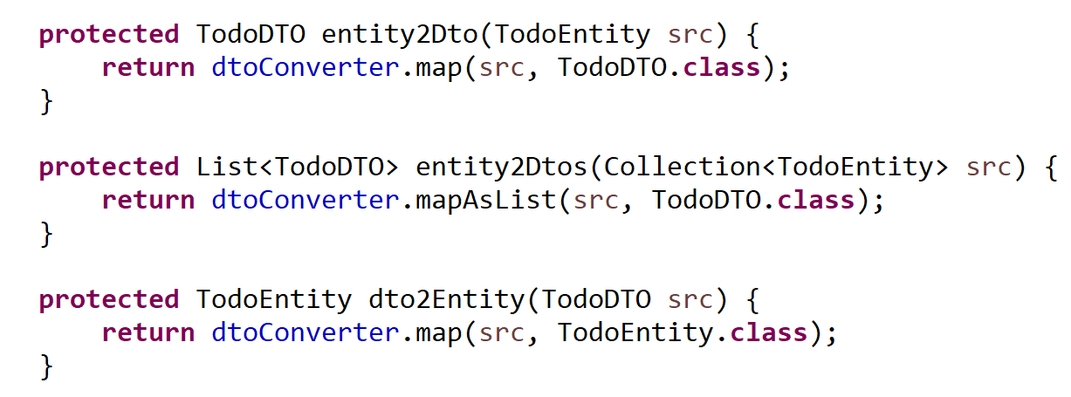
entity2Dto / dto2Entity using generic signature and « .class »

Slide 35
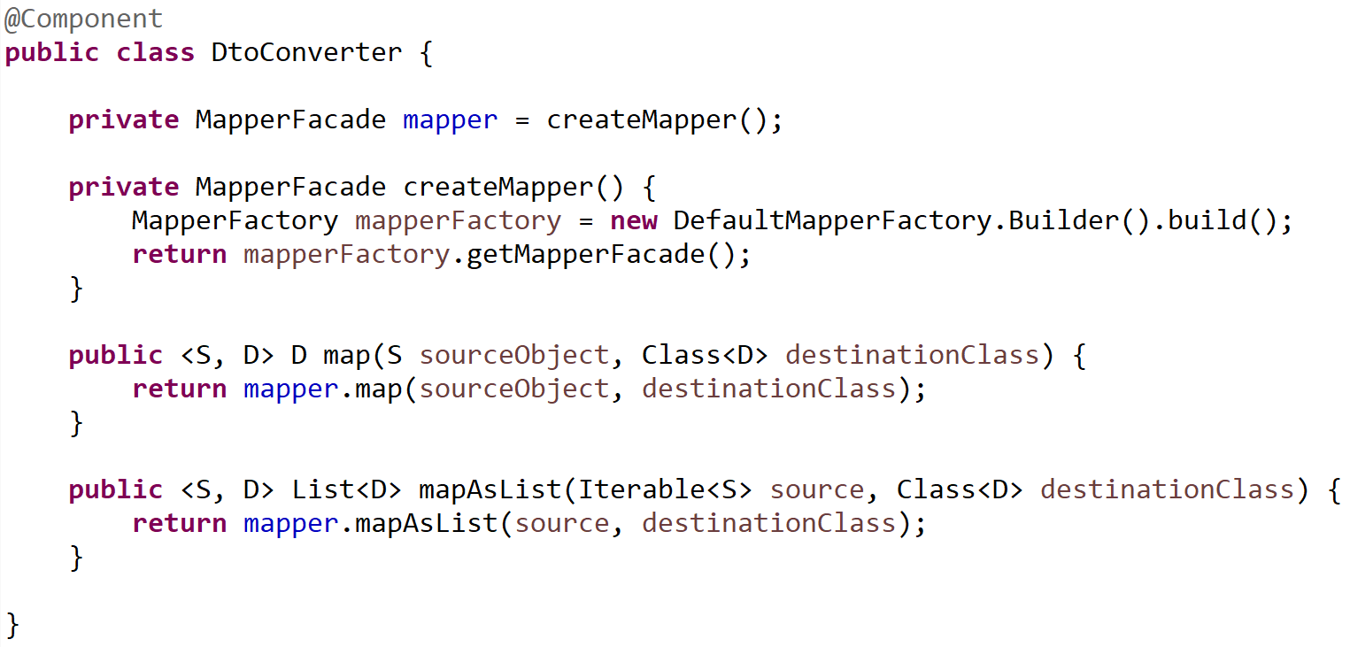
Using Orika MapperFacade

Slide 36
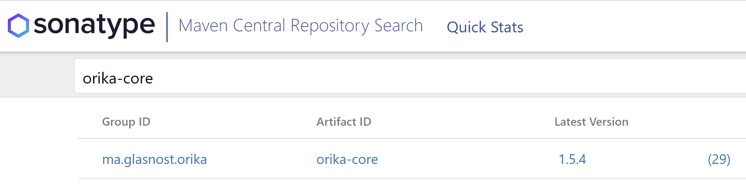
Orika
<dependency>
<groupId>ma.glasnost.orika</groupId>
<artifactId>orika-core</artifactId>
<version>${orika.version}</version>
</dependency>
https://search.maven.org/search?q=orika-core

Slide 37
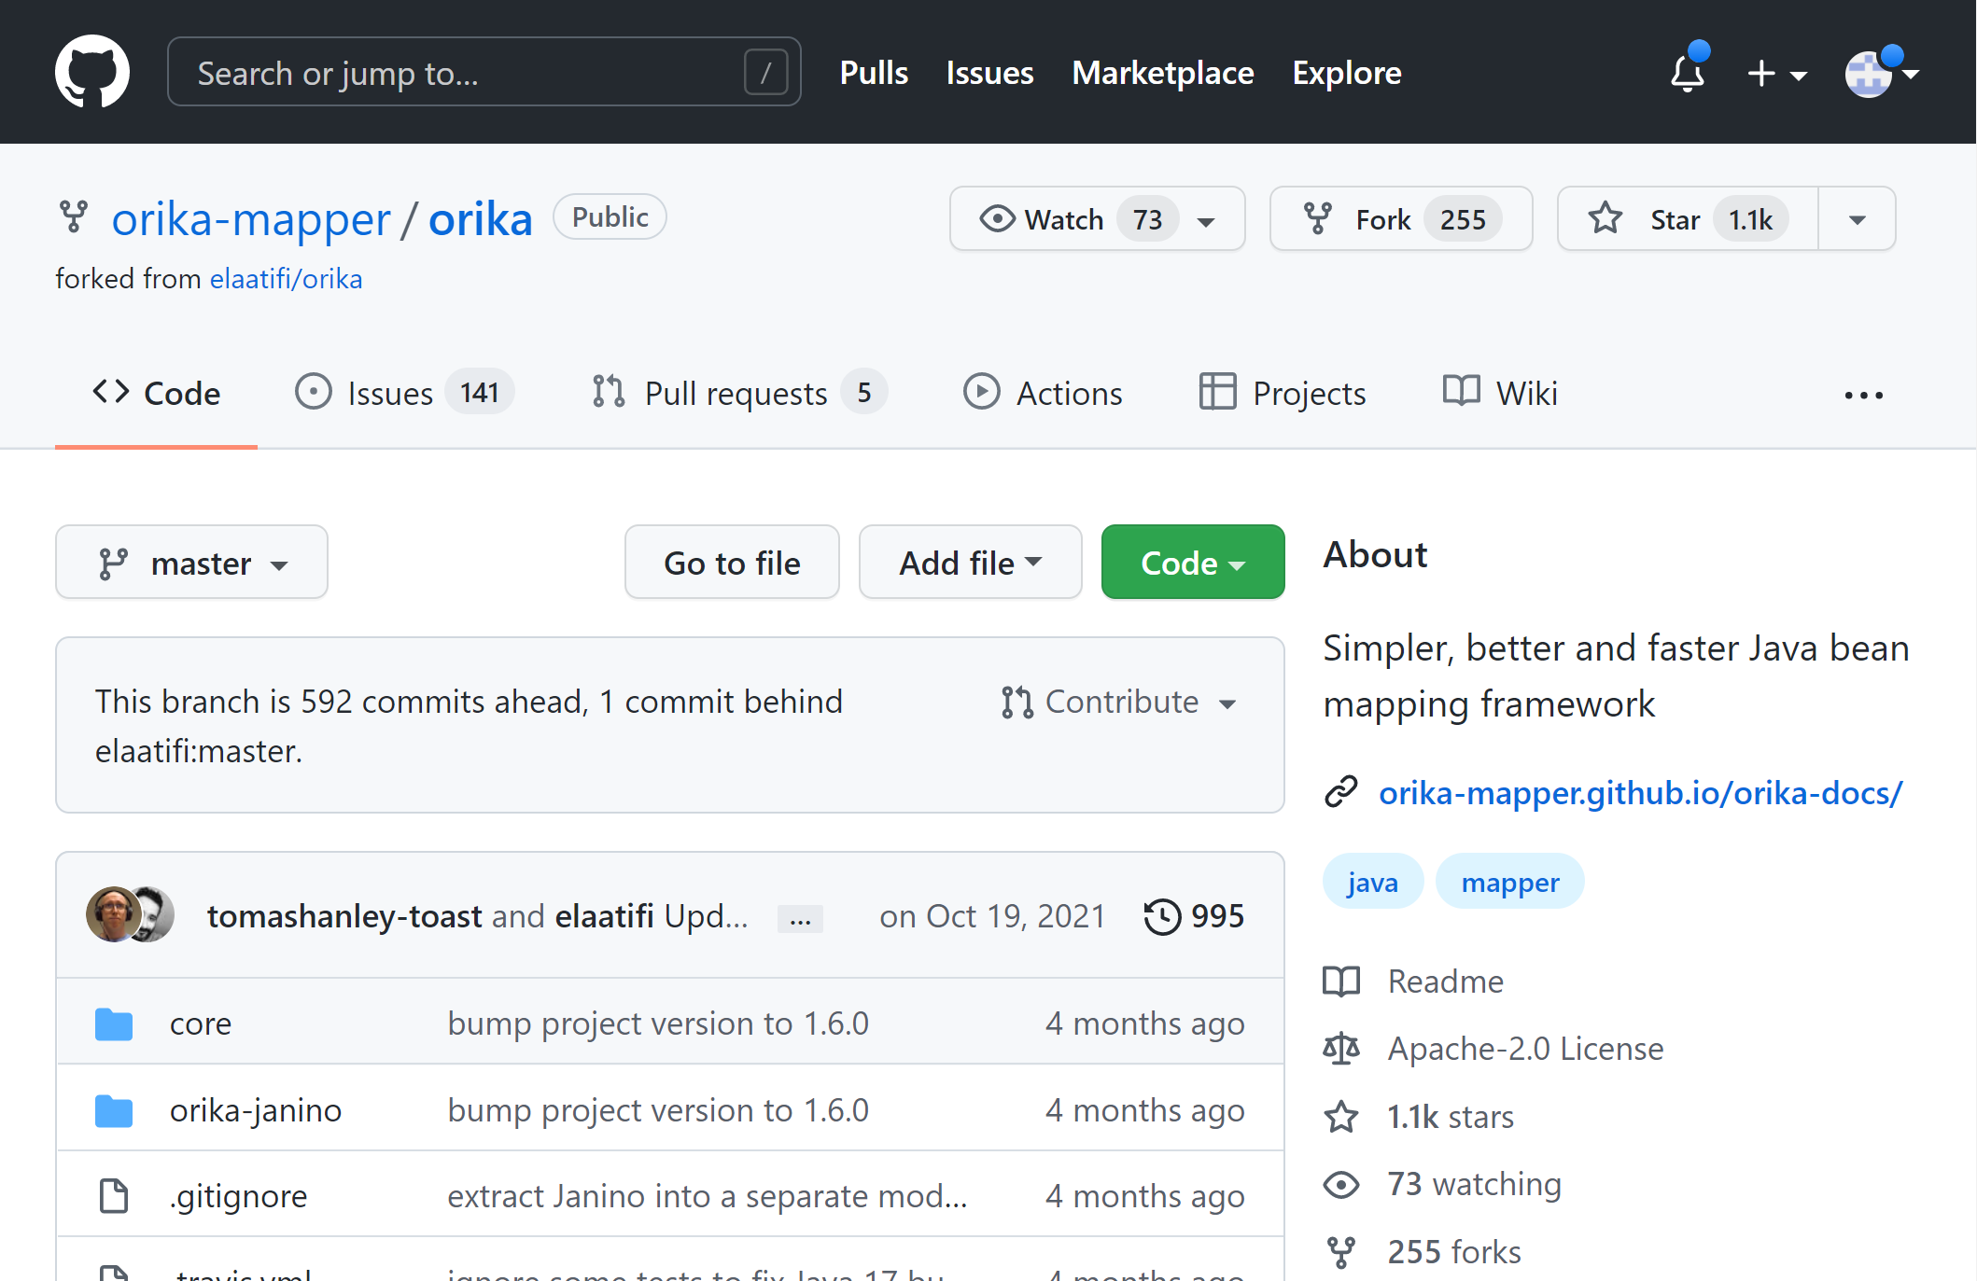
https://github.com/orika-mapper/orika

Slide 38
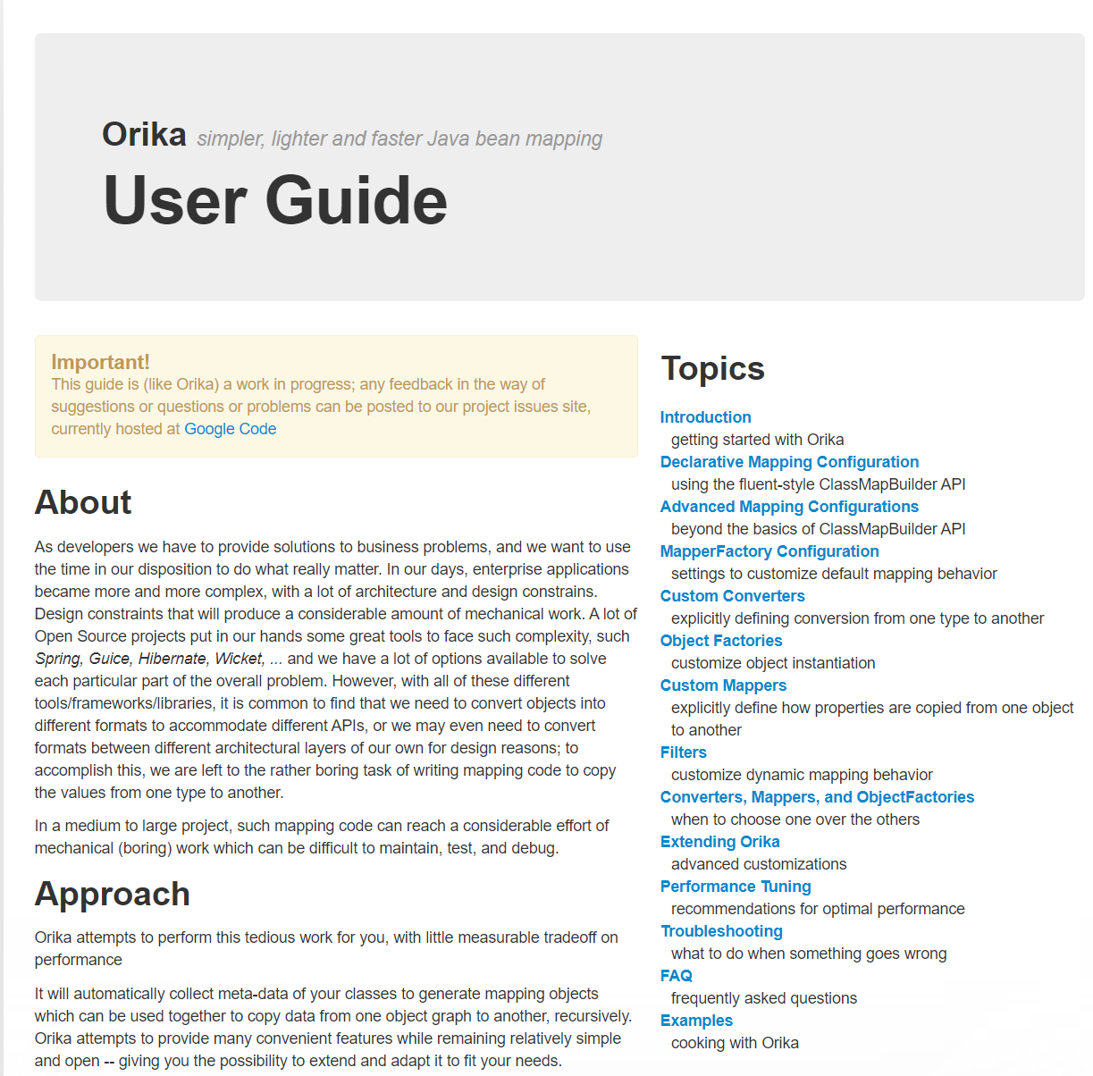
http://orika-mapper.github.io/orika-docs/

Slide 39
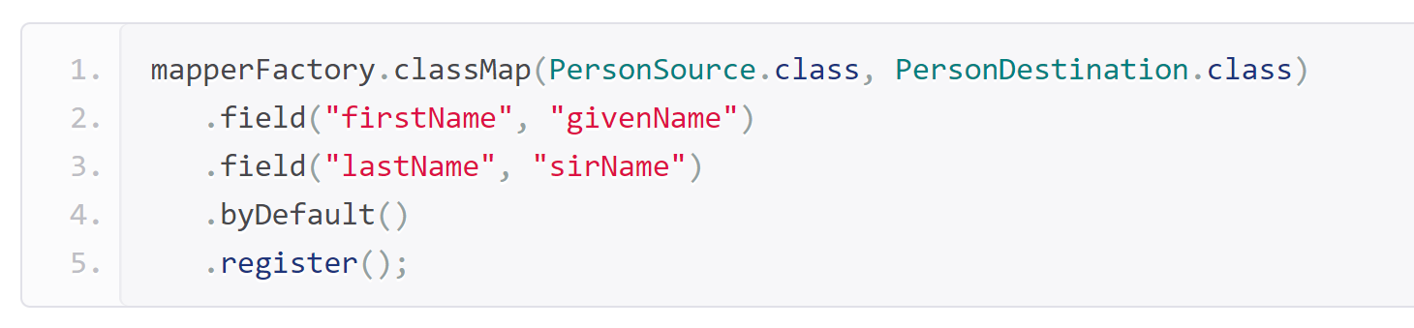
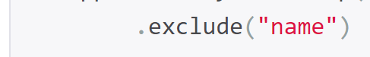

Orika Intro … customizing Class Mapper
Override custom
Bi-Directional field Mapping
= fieldAtoB + fieldBToA
Convention over configuration
Explicit Single-Directional
fieldAtoB != fieldBToA

Slide 40

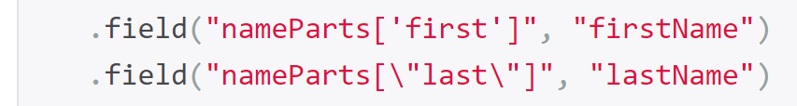
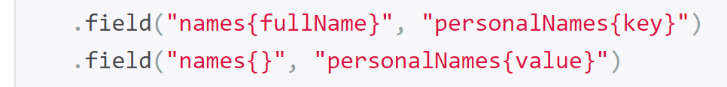
Customizing… mapping different structures
Nested field class <-> flat field
Default nested naming Convention !!!
« aaaBbb » <-> « aaa.bbb »
List<..> by index <-> flat field
Map<Key,..> <-> flat field
List<Nested field class> <-> Map<String,..>

Slide 41
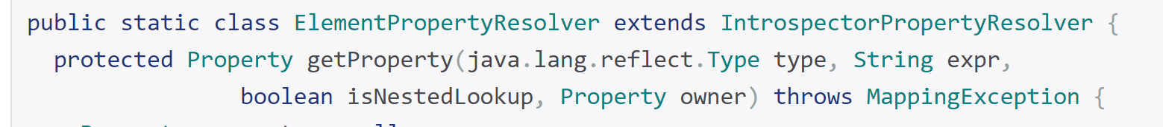
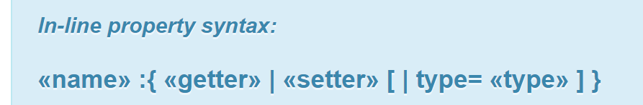
Customizing Properties Naming Conventions
Naming convention
for all Properties
Details
Naming convention
for 1 Property

Slide 42
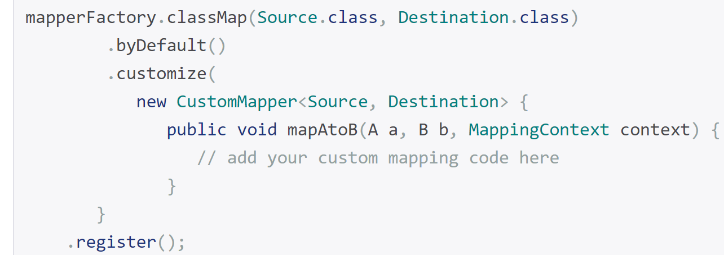
Customizer Mapper
override default Class to Class
Custom Mapper
(handle specific fields only)
Details
Class to Class Full
Custom Mapper
(handle all fields)

Slide 43
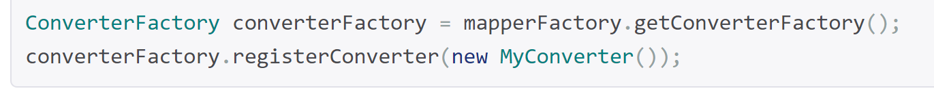
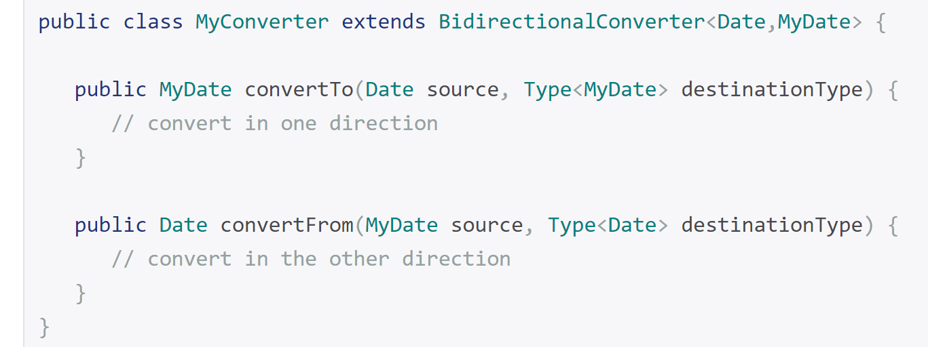
Custom Per Type Converter (apply to all type1<->type2 properties)
Details

Slide 44
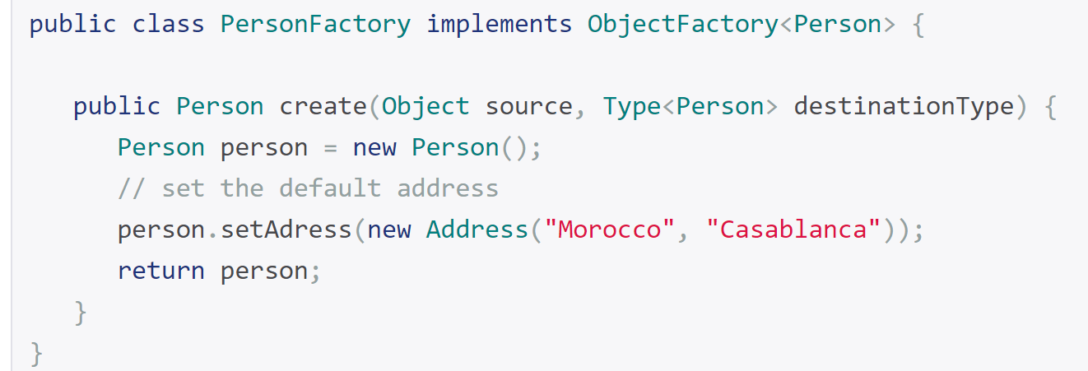
Custom « new » Object Factory
Details

Slide 45
More customizations … Filter
customize dynamic mapping behavior
Details

Slide 46
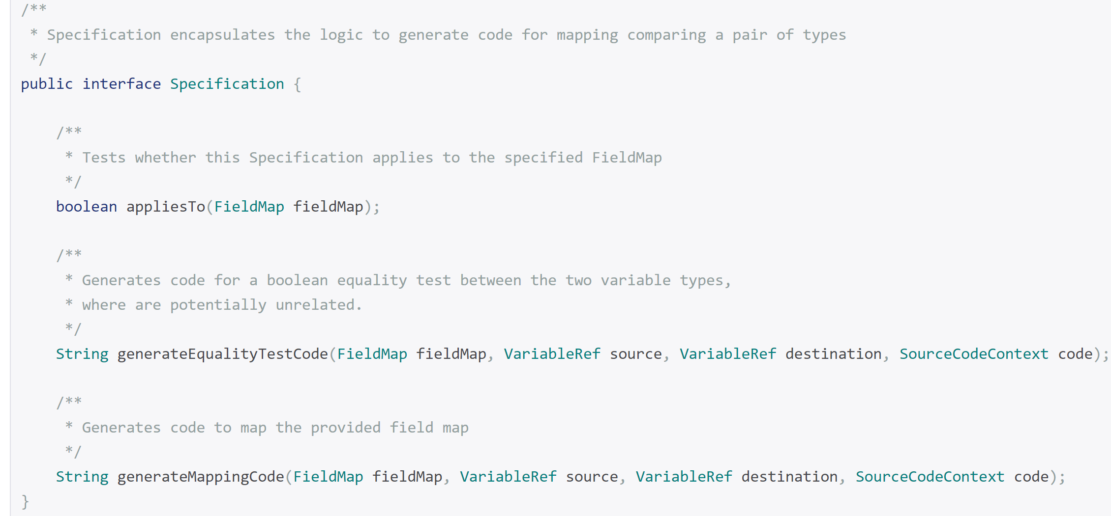
Code Generator Options
Details

Slide 47
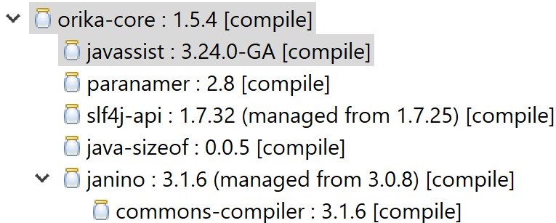
Code Generated ??? YES !!!
DEFAULT: javaassist
ma.glasnost.orika.impl.generator.JavassistCompilerStrategy
ma.glasnost.orika.impl.generator.JaninoCompilerStrategy
strategy
Janino
(also in logback)
Opaque « .class » bytecode …
Default NO generated/debuggable « .java » Source
EclipseJdt
ma.glasnost.orika.impl.generator.EclipseJdtCompilerStrategy
add
<dependency>
<groupId>ma.glasnost.orika</groupId>
<artifactId>orika-eclipse-tools</artifactId>
<version>${orika.version}</version>
</dependency>
Debuggable
« .class » bytecode + generated « .java » Source-Code with Line numbers

Slide 48
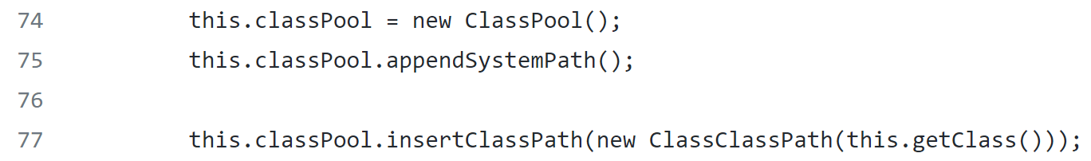
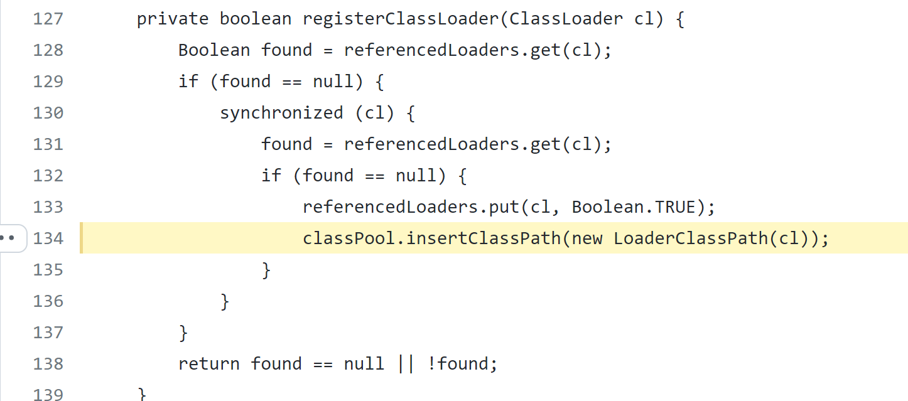
Javaassist + register ClassPool in ClassLoader
https://github.com/orika-mapper/orika/blob/master/ core/src/main/java/ma/glasnost/orika/impl/generator/JavassistCompilerStrategy.java#L134

Slide 49
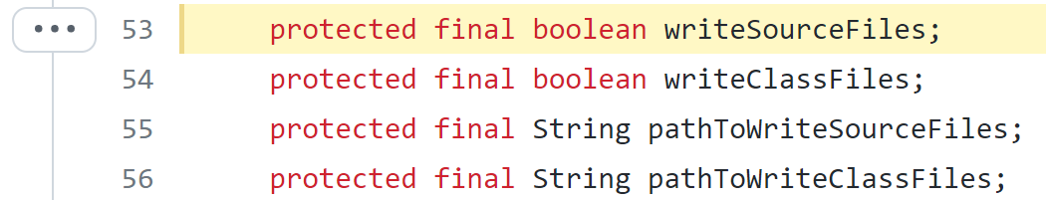
Writing Generated Classes..
https://github.com/orika-mapper/orika/blob/master/ core/src/main/java/ma/glasnost/orika/impl/generator/CompilerStrategy.java#L53
Using System.properties
ma.glasnost.orika.writeSourceFiles
ma.glasnost.orika.writeClassFiles
ma.glasnost.orika.writeSourceFilesToPath
ma.glasnost.orika.writeClassFilesToPath

Slide 50
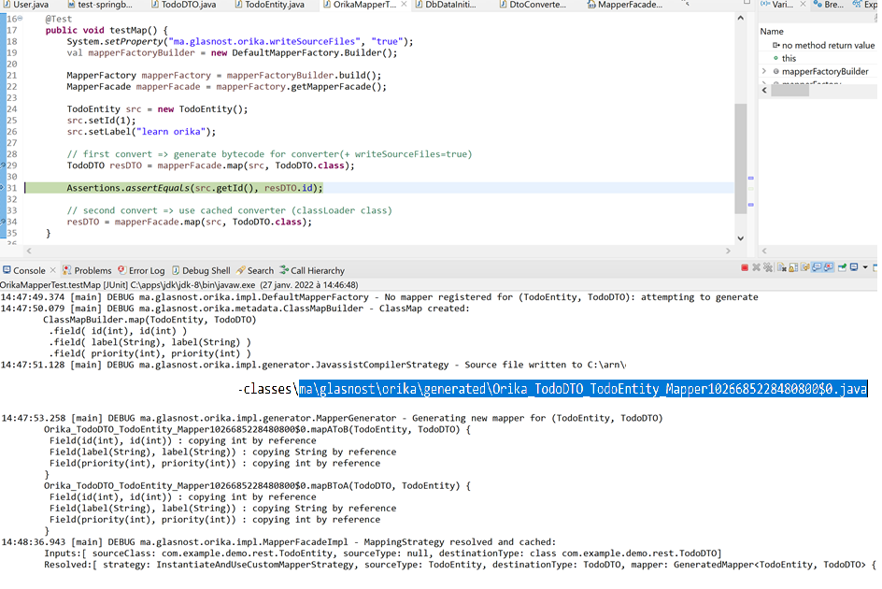
First call map() => generating Mapper for (ClassA,ClassB)

Slide 51
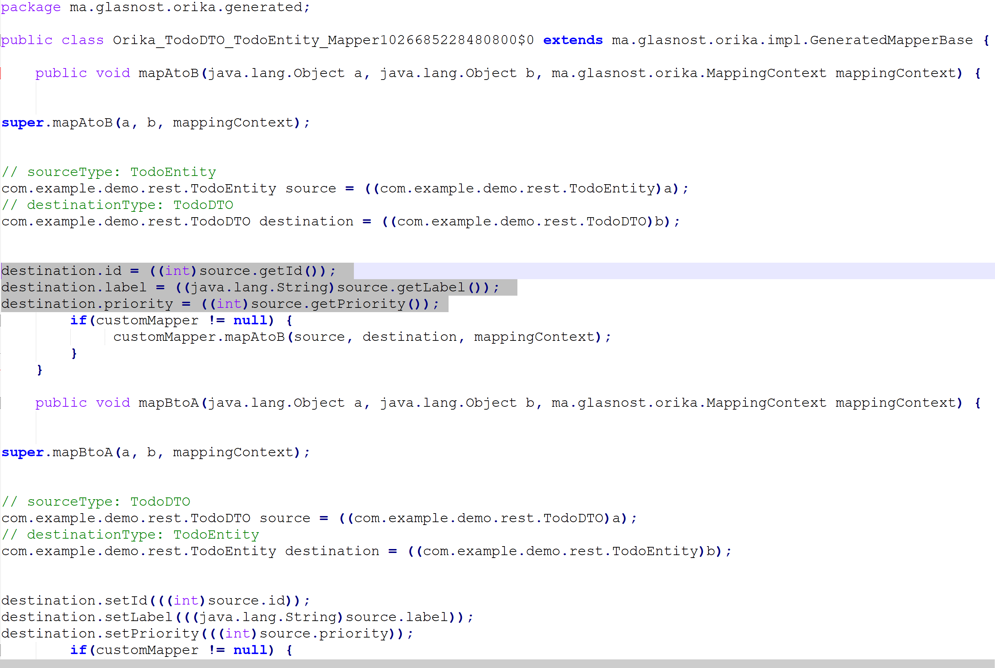
Generated code.. (file not visible in Eclipse?)
Optimal compiled code
Entity -> DTO
(with extra cast)
Optimal compiled code
DTO -> Entity
(with extra cast)

Slide 52
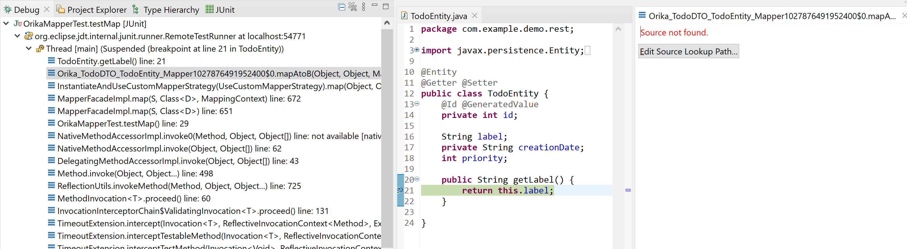
Generated Code .. Source not visible in Eclipse

Slide 53
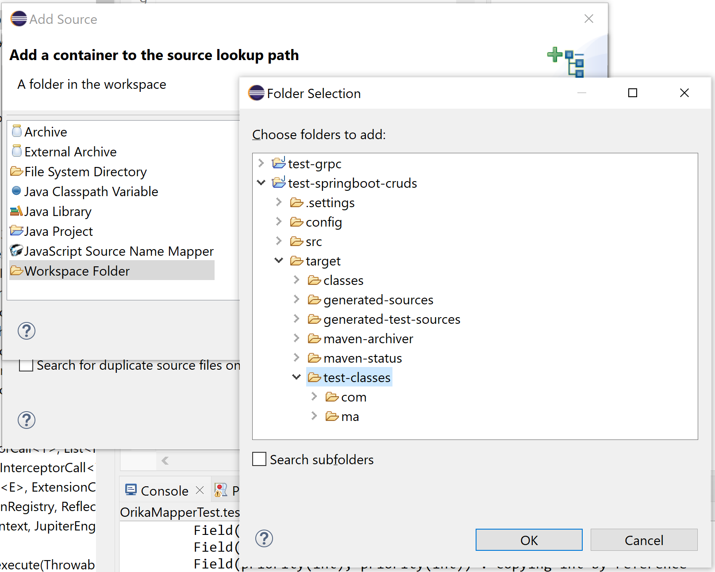
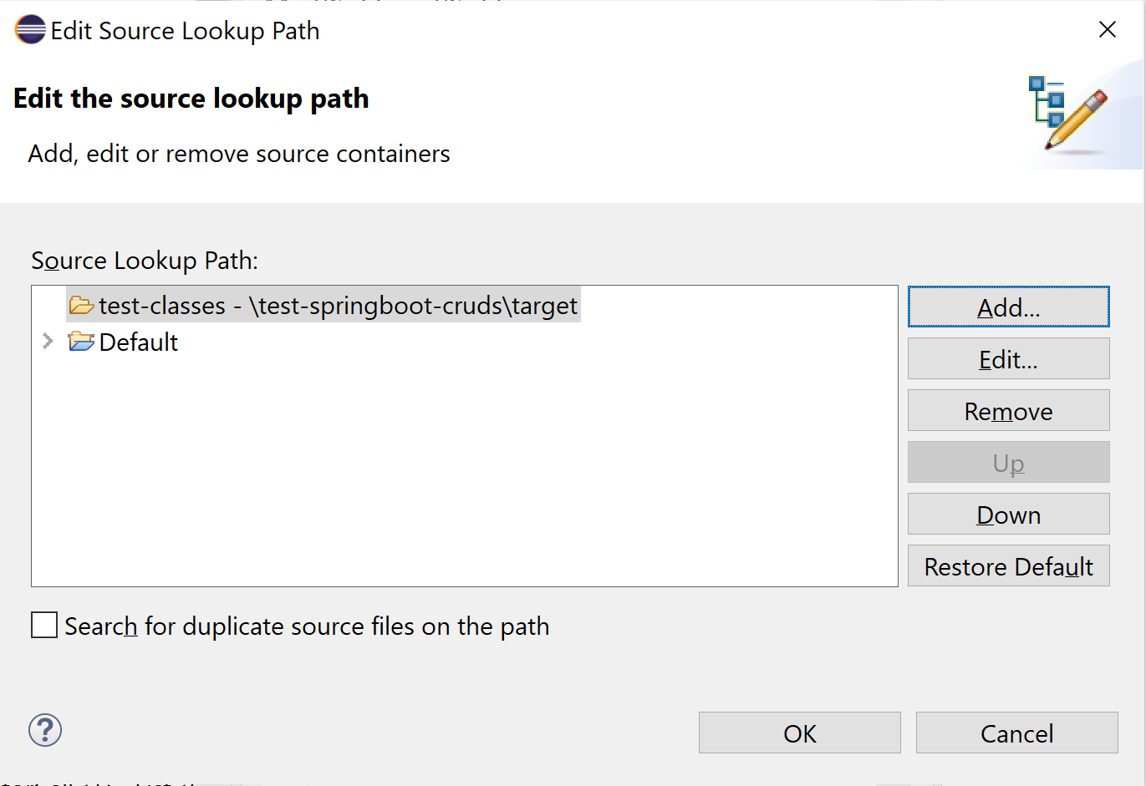
Adding Source

Slide 54

Debugging « Line Number » info not available! ( mode javaassist … switch to mode EclipseJdt )
Supposed to be here
« .getLabel() »
Line 18 … ??

Slide 55


Activating EclipseJdtCompilerStrategy

Slide 56
Orika = the « Simpler, faster and better Java bean mapping framework»
1/ Ultra FAST (as fast as optimized hand-written code)
2/ Ultra concise API … convention of configuration
3/ fully customizable if needed
4/ No need to configure compile-time code generator / IDE plugins
5/ can still see generated code in IDE, on demand
-- NO built-in recognized support for findById() « id » <-> « entity » in JPA + springboot
NOT suitable for JPA « merge » / need business logic code

Slide 57

Orika Alternatives
« MapStruct » chosen in JHipster
++ code generated at compile-time
-- … need IDE plugins / config
-- need to declare all methods signatures in interfaces
Non viable legacy ideas
« Dozer » !!
Old, buggy, NO code generated
Very bad performances
Fully by introspection

Slide 58

MapStruct (alternative chosen in Jhipster )
https://mapstruct.org/

Slide 59

https://github.com/mapstruct/mapstruct

Slide 60
Orika … no findById in Springboot/JPA ?
-- NO built-in recognized support for findById() « id » <-> « entity » in JPA + springboot
NOT suitable for JPA « merge » / need business logic code

Slide 61
Mapping Entity-DTO + Entity – ID findById !!
XEntity
entityToDTOId
XDTO
@ManyToOne( fetchType=LAZY)
0..1
0..1
YEntity
YLightIdDTO
YDetailedDTO
Update XEntity
… do not put invalid empty object in session !!
do not « clean » existing YEntity content !!
do not create new empty YEntity !!
« attach » / « detach » existing Entity by ids
dtoIdToEntity
Edit on Client-side …
- change some fields ( no change ManyToOne )
- Change ManyToOne relation

Slide 62
Reminder findById() … unique Object in Session per Id
Level1Cache
(=Session )
Read-Write, single-thread
Level2Cache
(=Global)
Read-Only, multi-threads
Thread
XA (Transaction)
a.getB()
lookup in Level2Cache
Perform jdbc « select … where id=? »
If ! already
lazy fetched
b = brepo.findById(id)
Clone read-only cached to (read-write) Entity
Fill Entity from Jdbc
+ put in cache
Lookup in Level2Cache
If found => return pointer

Slide 63

Buggy code.. « new Entity(id) + mapper (un-customized) »

Slide 64



do NOT use « new Entity(id) + mapper (un-customized) » need JPA merge? … use JPA findById() !!
Detached
(invalid) entity

Slide 65
… BUG return invalid after entity2dto …
DTO from « detached entity »
… invalid (not merged ) => put in session instead of real entity
But value in DB is OK …

Slide 66

Sending invalid « id » not in DB … 500 (in commit) instead of 400 (find in user code)
http 500 … failed on « server-side » … should be http 400: bad client input

Slide 67


Correct mapper with findById

Slide 68

invalid « id » … bug in Hibernate getById => {id=0} BUG!! findById => null OK
Do not trust fields … hibernate use « ByteBuddyInterceptor » + store in handler

Slide 69


Getting correct 404 for invalid id

Slide 70

Save + setRef … without save(ref) (no « Cascade Create » )

Slide 71
Mapper + Hibernate + Transaction
-- NO built-in recognized support for findById() « id » <-> « entity » in JPA + springboot
NOT suitable for JPA « merge » / need business logic code
Hibernate is a MESS
BUG : put invalid « un-merge » Entity in session
BUG : no EntityNotFoundException error code
Can not see field values at debug type, use ByteBuddyInterceptors … duplicate memory needs
Switch to EclipseLink (reference implementation of JPA)

Slide 72
More problems…
Hard-coded DTO API to chose field projections (and cut other fields)
1 rule does not fit all clients

Slide 73
DTO fields computation + transfer
For some clients : not enough fields in DTO … need more
=> client loop many http calls
For some clients : too many (useless) fields in DTO … need less
=> slow on server to compute too many JDBC selects,
and transfering useless network data

Slide 74

GraphQL to the rescue ..
Switch to
java + annotation + springboot ecosystem for GraphQL
Much more powerfull & simpler than DTO + Mappers !!

Slide 75
Not enough fields in Api DTO client loop to enrich.. 1+N network calls
Call 1:
GET /api/..infos/..
Client
Client-side foreach loop
on {obj1}, {obj2} … {objN}
[ {obj1}, {obj2}, … ]
Rest Server
Need more detail on {obj1}
Call 2: GET /api/..detail/..{obj1.id}
{view-obj1}
{full-obj1}
{view-obj2}
… {enriched-obj1}
{full-obj2}
{view-objN}
{full-objN}
Call 3: GET /api/..detail/..{obj2.id}
Need more detail on {obj2}
…
Server may have FULL objs
But forgot/choosed to export
only partial projections
Call 3: GET /api/..detail/..{objN.id}
Need more detail on {objN}

Slide 76
Too Many fields in (useless) detailed DTO … server-side loop 1+N JDBC requests
Rest Server
List< …Info >
[ {obj1}, {obj2}, … ]
server-side foreach loop
on {obj1}, {obj2} … {objN}
Call
GET /api/..info1/..
Client
{view-obj1}
Need more detail on {obj1}
2 select detail..obj1.id
{view-obj2}
… {enriched-obj1}
{view-objN}
3 select detail ..obj2.id
Need more detail on {obj2}
Client does not need all
data transfered from server
…
N select detail ..obj2.in
Need more detail on {objN}

Slide 77
By-Passing « Query » « Entity » then to « DTO » … direct Query with JOINs to DTOs
Every application has a central « Search screen »
Such API must be highly optimized
Worth for back to the basics: « JPA QL » or plain old « Jdbc »
Do not optimize all apis in JDBC for maintenance/evolutivity

Slide 78

Direct JPA QL to DTO (or even Native SQL to DTO )
SELECT
p.id, p.field1, p.field2, p.ref_id, ref.field1, ref.field2
FROM direct_source_entity p
CROSS JOIN direct_reference_entity ref
WHERE p.ref_id=ref_.id
and p.field1 like ?
1 SQL request

Slide 79
GraphQL specific query on client – Answer exact from Server
http + JSON:
{ request: «
{ view-obj graphQL fields }
»
}
GraphQL Client
GraphQL Server
http + JSON:
{ data: [ {view-obj1}, {view-obj2}..
{view-objN}],
message: null, error: null
}

Slide 80
GraphQL Main Features & Benefits…
RootQuery … ~ http GET + swagger
Strongly Typed schema + documented
discovery by introspection (metadata query)
Interactive Graphiql browser
Mutations … ~ http POST/PUT/DELETE actions
Subscriptions … ~ Web socket to subscribe
SIMPLER than DTO + Mapper + Projections/Cuts dilemna
& BEST evolutivity
& BETTER performances
NO pre-defined « all-in-one client data/prepared calls »
… See next lessons

Slide 81
Conclusions
Modeling Domain Entity / Optimizing Database was « essential & difficult »
Standard JSON marshalling/unmarshalling is done via DTO classes
and entity2dto / dto2entity mapper
Mapper in way « dto2entity » need complex JPA / Transactional code
(findById / save … otherwise strange bugs appear )
Exposing API with specific DTOs (choosing projections/cuts)
looks « accidentally difficult » …. GraphQL to the rescue

